Slide 1
Project 5 : USE OF SUBSET SUM ALGORITHM IN MULTIPROCESSOR SCHEDULING
ALGORITHM PROJECT
TEAM MEMBERS :
Kurra Bavanya Choudhary : 18075034
Madhulika Damor : 18075037
Radhika Singh : 18075046
UNDER THE GUIDANCE OF
Prof Dr. RAVI SHANKAR sir and NAVIN MANI UPADHYAY sir

Slide 2
ACKNOWLEDGEMENT
In the present world of competition there is a race of existence in which those are having will to come forward succeed. Project is like a bridge between theoretical and practical working.
First of all we would like to thank our Prof Dr. Ravi Shankar sir who have us the opportunity to do this wonderful project.
We would like to express thanks of gratitude to our tutor Navin Mani Upadhyay sir for their guidance, suggestions, instructions and support in various phases of completion of our Project.
Last but not least we would like to thank our classmates who have help us a lot.
Date : 30 April 2020

Slide 3
INTRODUCTION
Scheduling processes efficiently in a multiprocessor environment using the best optimization algorithm is very much important to maximize the CPU utilization.To achieve this, we have implemented a scheduling algorithm which uses subset sum algorithm and quick sort to maximize the CPU utilization
The main idea behind our approach is to free up as many CPUs as possible and reducing the idle cycles. This also reduces the waiting time of other processes which arrive in the waiting queue of the processors

Slide 4
APPROACH
To improve the throughput of the system, we implemented a task scheduling algorithm which uses a subset algorithm to divide the processes among the CPUs.
Process with a maximum amount of load is considered to be maximum boundary and the remaining processes whose loads sum up to this maximum boundary are scheduled into a single processor. Thereby freeing idle CPU cycles.
maximum boundary = ∑ t[i] ≤ t_max, where i goes from 0 to k.
The task reallocation solution for the packing is carried out by the Subset Sum algorithm, a particular case of the Knapsack problem.

Slide 5
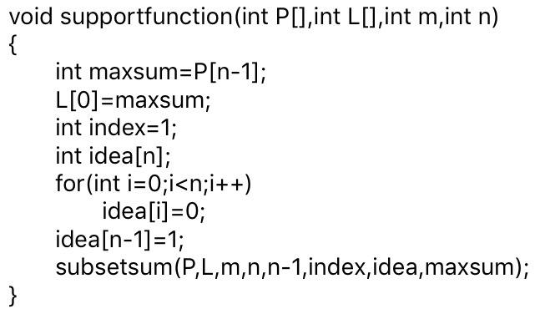
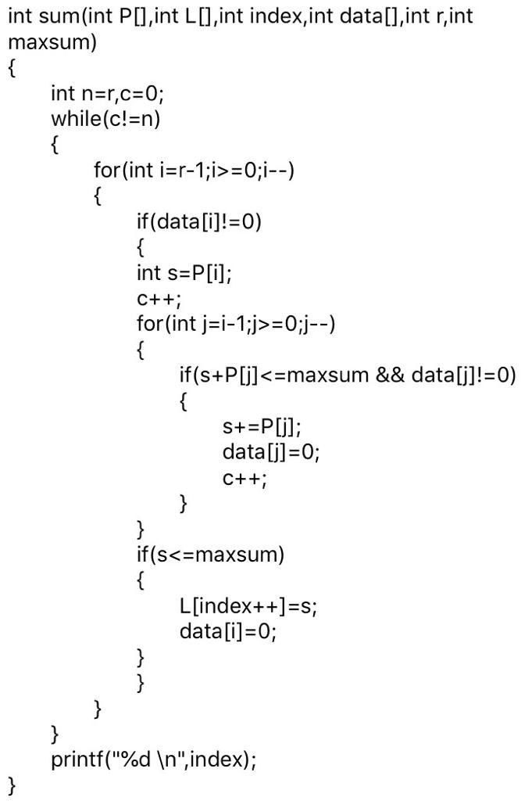
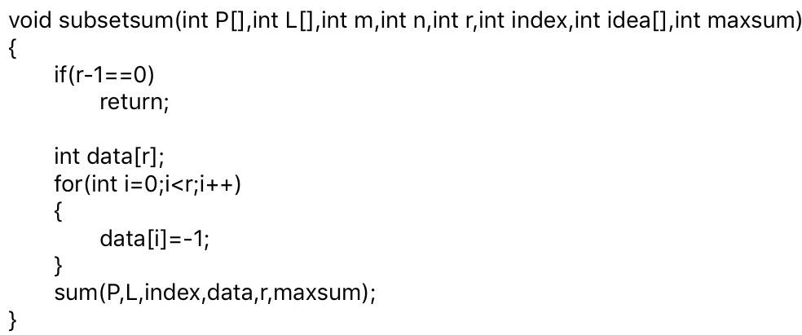
PROGRAM CODE
supportfunction(), subsetsum(), sum() and quicksort() functions are implemented as follows.

Slide 6
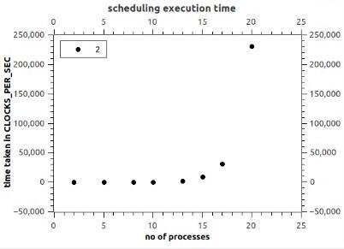
EVALUATION ON QTIPLOT APPLICATION
Very sharp increase in the execution time is observed when the number of processes approaches 20. This behaviour can be accounted to the complexity of the subset sum algorithm on which our algorithm is based.

Slide 7
CONCLUSION AND FUTURE WORK
In this work, we provide our scheduling algorithm for the distribution of tasks as per their loads on the multiple CPUs. Subset sum problem we have used here is NP-complete, so the solution that can be obtained in polynomial time may not be an optimal one.
In future works, we may come up with the optimal solution to apply to our scheduling mechanism and get the benefits. Our code performs scheduling for multiprocessors. For better simulations of the algorithm, development of the code for different nodes is to be done.

Slide 8
REFERENCES
E. S. H. Hou, N. Ansari and Hong Ren, "A genetic algorithm for multiprocessor scheduling," in IEEE Transactions on Parallel and Distributed Systems, vol. 5, no. 2, pp. 113-120, Feb. 1994.
Miklos Ajtai, James Aspnes, Moni Naor, Yuval Rabani, Leonard J Schulman, Orli Waarts, "Fairness in Scheduling, Journal of Algorithms",Volume 29, Issue 2,1998,
Alhussian, Hitham & Zakaria, Nordin & Hussin, Fawnizu Azmadi. (2014). An Efficient Real-Time Multiprocessor Scheduling Algorithm. Journal of Convergence Information Technology.
Goossens, J., Funk, S. & Baruah, S. Priority-Driven Scheduling of Periodic Task Systems on Multiprocessors. Real-Time Systems 25, 187–205 (2003). https://doi.org/10.1023/A:1025120124771
A hierarchical multiprocessor scheduling framework for DSP applications," Proceedings of the IEEE Asilomar Conference on Signals, Systems and Computers, 122-126 vol.1, Pacific Grove, California, November, 1995.
E. Horowitz, S. Sahni, Computing partitions with applications to the
knapsack problem, J. ACM 21 (2) (1974) 277–292
Gladys Utrera, Montse Farreras, Jordi Fornes. “Task Packing: Efficient task scheduling in unbalanced parallel programs to maximize CPU utilization”, Journal of Parallel and Distributed Computing 134 (2019) 37–49.
https://github.com/azeemshaikh38/MultiprocessorScheduler
https://www.geeksforgeeks.org/print-subsets-given-size-set/
https://github.com/srjit/task-scheduling-algorithm

Slide 9
THANK YOU !!

